Slide 1
Hopfield networks
Artificial Neural Networks and Deep Architectures – Lab 3
Fredrik Danielsson, Franco Ruggeri, Kevin Dalla Torre

Slide 2
Convergence and Attractors Synchronous updates
Self connections | # Converged | # Attractors
Yes | 2 | 14
No | 1 | 6
Self connections → more spurious patterns
Synchronous updates → no convergence guaranteed (it can end up alternating between two state at the same energy)

Slide 3
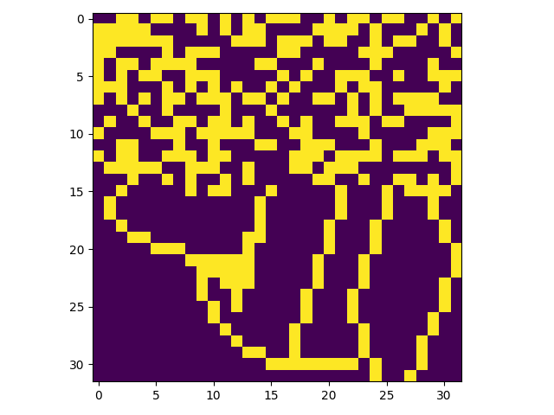
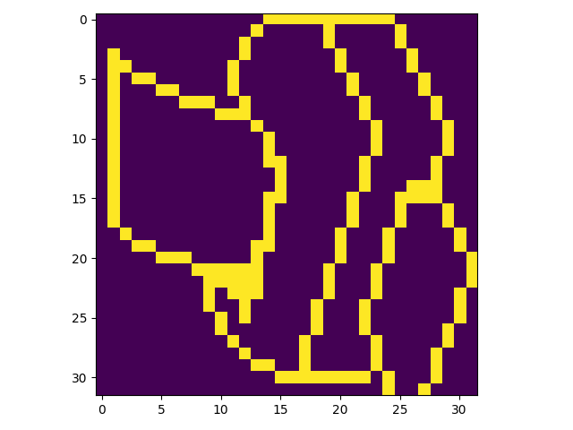
Pattern completion
…
Hopfield networks can complete degraded patterns very well.

Slide 4
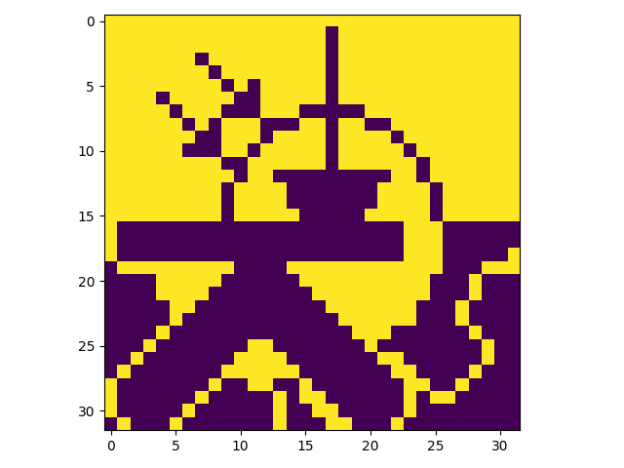
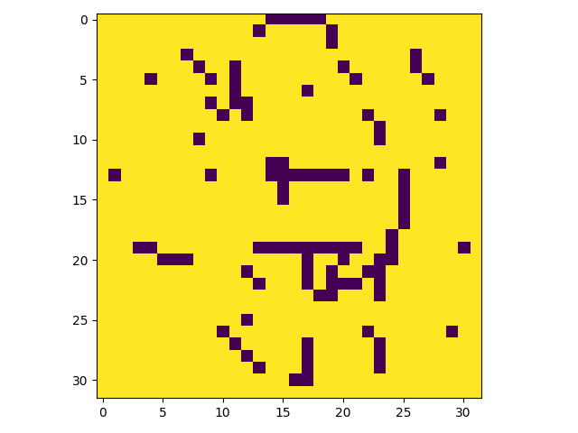
Pattern completion Spurious patterns
…
Problem 1: there are also spurious attractors (at least negations of patterns).

Slide 5
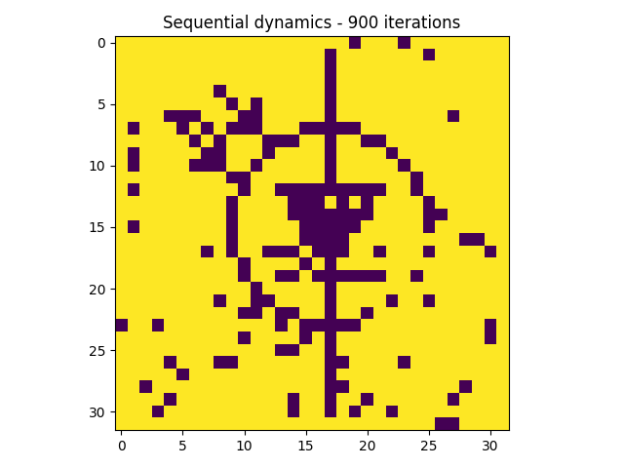
Pattern completion Corrupted bits
…
Problem 1: there are also spurious attractors (at least negations of patterns).
Problem 2: there can be corrupted bits.

Slide 6
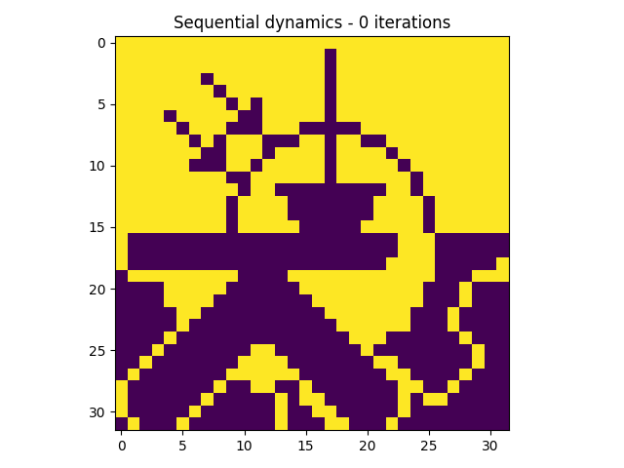
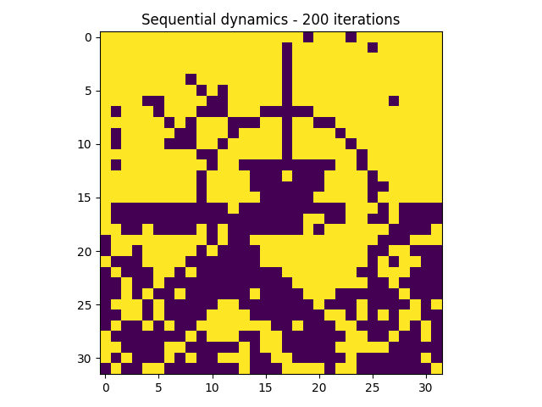
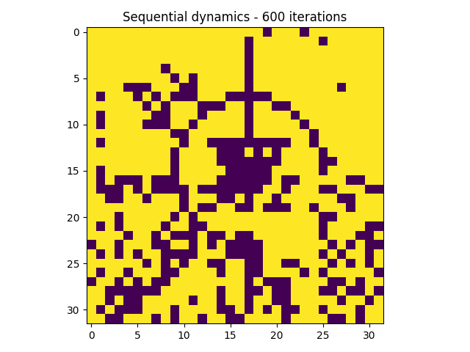
Pattern completion Sequential update
Convergence guaranteed.
Depends on the random order, can converge to different attractors.

Slide 7
Energy Attractor vs Starting state
Starting state / Attractor | Energy
Attractor of p1 (== starting state p1) | -1436.39
Attractor of p2 (== starting state p2) | -1362.64
Attractor of p3 (== starting state p3) | -1459.25
Attractor of p10 | -1436.39
Attractor of p11 | -1368.23
Starting state p10 | -412.98
Starting state p11 | -170.50
Stored patterns → fixed points (stable points) (if enough capacity…)
Energy at attractor ≤ energy at starting state (= only if the starting state is a fixed point)

Slide 8
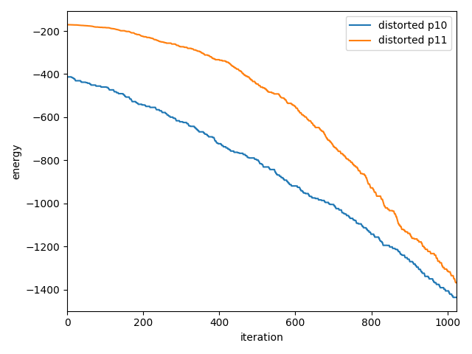
Energy Noise reduction
Energy decreases at each change of state.
Convergence to local minimum (attractor) guaranteed.
Conditions: asynchronous updates and…

Slide 9
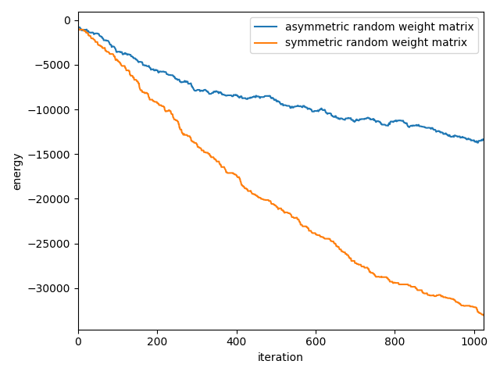
Energy Symmetric vs asymmetric
Energy decreases at each change of state.
Convergence to local minimum (attractor) guaranteed.
Conditions: asynchronous updates and symmetric matrix.

Slide 10
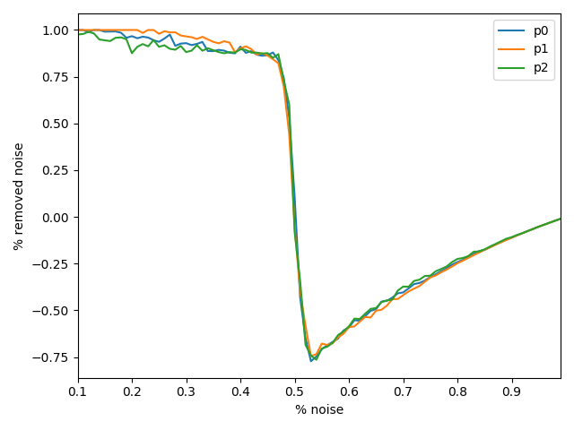
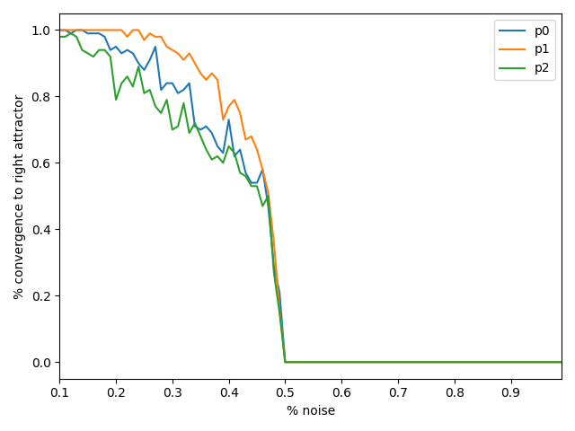
Distortion resistance
Hopfield networks are very effective at removing noise
Clear and sudden drop off at 50% noise, when the attractor is not the right one anymore
Slightly different behavior of the different patterns, they each have a different basin of attraction.

Slide 11
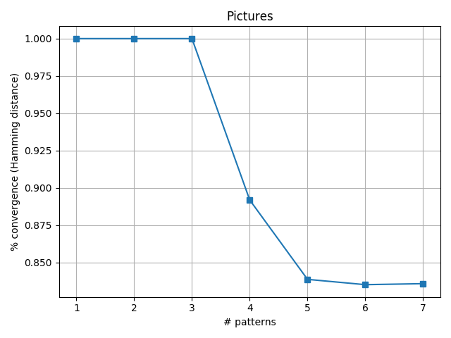
Capacity
Pictures
Can only reliably store 3 pictures.
Lots of similarity between the pictures, leads to lesser memory capacity, more crosstalk between patterns.
Abrupt drop in performance, but some pictures could still be recognized.

Slide 12
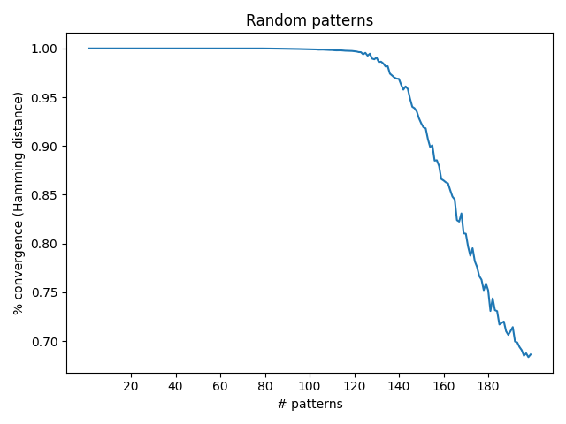
Capacity
Random patterns
On the other hand, dramatic increase in memory capacity when patterns are random.
This is explained by the fact that they are well distributed and the patterns are more orthogonal than the pictures.
The memory capacity for a Hopfield Network is around 0.138N, which is respected here.

Slide 13
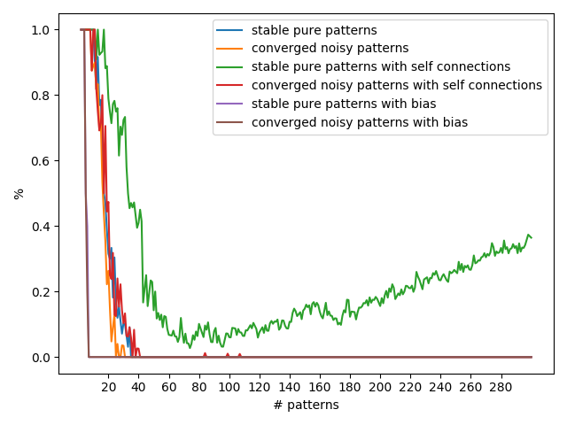
Capacity
Pure and noisy patterns
Biased patterns → decreased memory capacity (patterns become less orthogonal).
Self connections → better capacity (states are more stable, state change more difficult).
Self connections with high number of patterns → very strong self connections (diagonal), the network returns just the same pattern.
Pure pattern → pure pattern → GOOD, green curve, but…
Noisy pattern → noisy pattern → BAD, no noise reduction, useless network.
Without bias, the theoretical memory capacity (0.138N) is respected

Slide 14
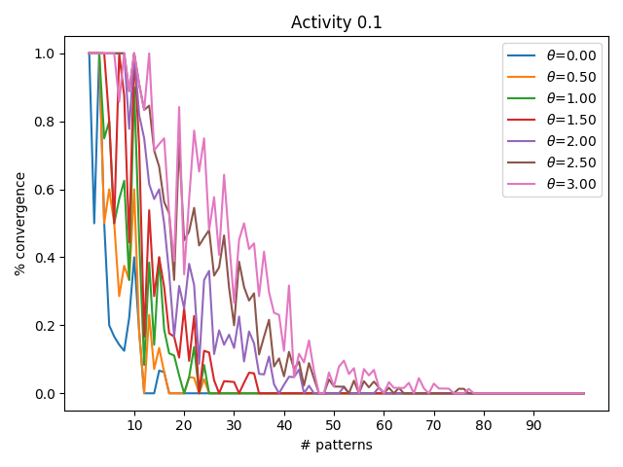
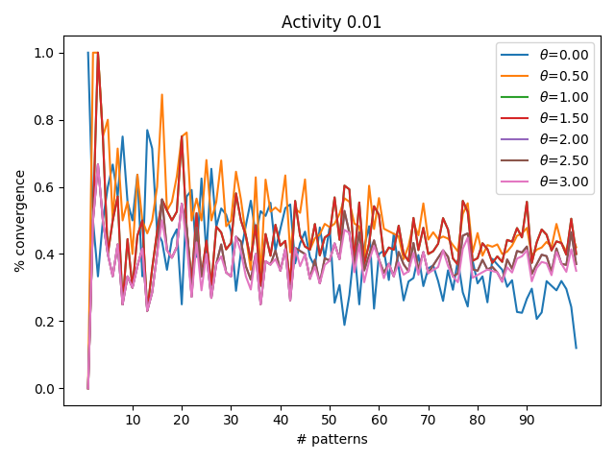
Sparse patterns
The more sparse the patterns, the better capacity
The higher activity, the higher bias value needed

Slide 15
THANK YOU!

